Slide 1

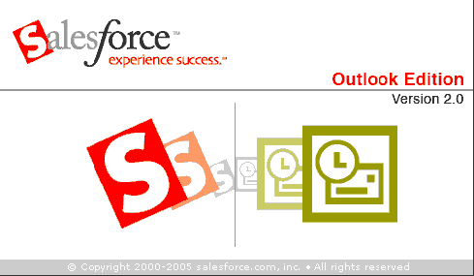
Salesforce CRM
Salesforce.User Guide Site: http://tinyurl.com/2ajcpgs
Salesforce Blog: http://salesforceatrutgers-sci.blogspot.com/
Notes:
http://www.thesoundarchive.com/sw.asp
http://members.tripod.com/SoundBytes1/star_wars/sw.html
Star wars sound files
Salesforce ideas site: https://sites.google.com/a/dceo.rutgers.edu/salesforceideas/
Ask barb about the blue ocean strategy – retreat data

Slide 2
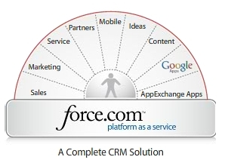

About Salesforce
Salesforce.com is a Customer Relationship Management (CRM) solutions vendor
Delivered using the software as a service model.
Notes:
Before we begin to discuss the details of salesforce and how it can be useful in your world, I think it is important to first provide you with a brief introduction to the cloud computing and web 2.0 in general in order to give you a full scope of this powerful tool and help better understand the advantages of the CRM. A CRM is a custom relationships management tool, basically think of it as a database that manages the data of a full cycle of a student. With salesforce this CRM is delivered using an online application via the SAAS model. This model is based on, cloud computing, the latest trend in technology.

Slide 3

Cloud Computing
Cloud computing is a style of computing in which dynamically scalable and often virtualized resources are provided as a service over the Internet.
Users need not have knowledge of, expertise in, or control over the technology infrastructure in the "cloud" that supports them. (wikipedia)

Slide 4
Software as a Service
In the past software programming was once static, Saas allows for dynamic attributes.
The Saas model allows a vendor to click a button and deploy a new version to over 47,000 companies utilizing its services.
  “Salesforce.com is by far the best-known example among enterprise applications, but SaaS is also common for HR apps and has even worked its way up the food chain to ERP, with players such as Workday. And who could have predicted the sudden rise of SaaS "desktop" applications, such as Google Apps and Zoho Office?”
  (http://tinyurl.com/c48vdd)

Slide 5
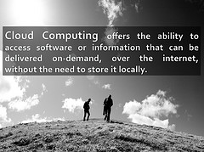
What is Cloud Computing?

Slide 6
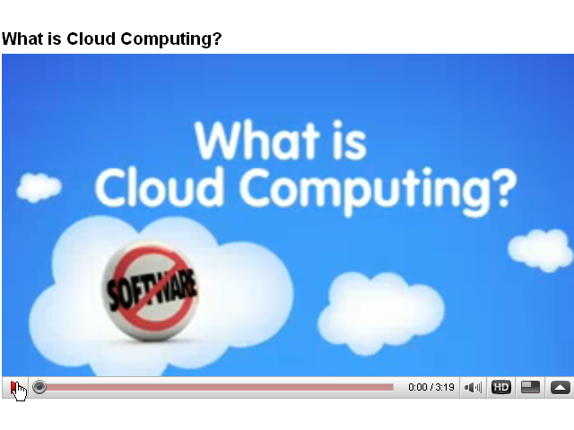
Video: What is Cloud Computing? (3:19)

Slide 7
How does cloud computing benefit ME?
Software as a Service
  Seamless interface upgrades
    No techie needed to install the latest version.
    Web based application allows for access from any computer or any device
Platform as a Service
  Easily add or customize field names across objects.
  Scaleable-Additional applications available for integration via the appexchange
Hardware as a Service
  Ample Data Storage
    No need to worry about upgrading the server or exceeding space capacities
  Security
    Salesforce is a trusted site, for more information please visit trust.salesforce.com
Notes:
New App – force.com Labs – Free
Security health check
http://sites.force.com/appexchange/apex/listingDetail?listingId=a0N300000018mjUEAQ
Description
Developed by the salesforce.com information security team, the Security Health Check application performs a quick review of your security-related settings and makes recommendations for improvement. The health check provides a numeric score and tracks your overall security posture over time.
The Security Health Check also notes administrative users, reviews your profiles and users to report on all users that have sensitive access rights, and reviews your default and custom sharing rules.

Slide 8
How can Salesforce benefit YOU?
Costs
  Receive a very reasonable non-profit rate ($300 per year per user license)
  Seasonal Upgrades Included
    Salesforce usually releases three new upgrades each year based on customer feedback
    To vote on a potential new idea for future salesforce release or suggest one of your own please visit: http://ideas.salesforce.com/
Notes:
Costs – corporations pay a much higher rate for using the same features
Ideas - (this area is for system enhancements not specific customizations needed for a group) – to suggest an idea for a particular customization please visit - ???

Slide 9

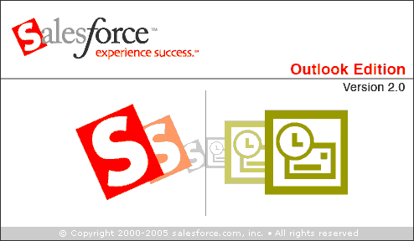
How does cloud computing benefit ME?
Force.com platform provides integration with other applications
  Google Apps
  Connect for Microsoft Outlook
  Connect for Microsoft Office
Notes:
Here are some examples of how you can benefit from the platform as a service model. Force.com platform provides integration with other applications
Such as MS Outlook, Office, & Google calendar. Tired of searching through your sent email folder for an email you previously sent to a student? Use the integrated features in order to easily attach a an email to a students record in sf
Close all Microsoft Office programs, including Word, Excel, and Outlook.
Click Setup | Desktop Integration | Connect for Office. In Enterprise and Unlimited Editions, your administrator may have prohibited access to the download page. For more information, see Setting User Permissions for Desktop Clients.
Click Install Now.
Click Yes when prompted to install Connect for Office. We recommend that you install Connect for Office to the default folder suggested by the installer.
After the installation completes, open Excel or Word, and select the salesforce.com menu to begin using Connect for Office.
The first time you open Word, you are prompted to enable macros from salesforce.com. You must enable the macros and accept salesforce.com as a macro publisher to use the Word add-in.

Slide 10
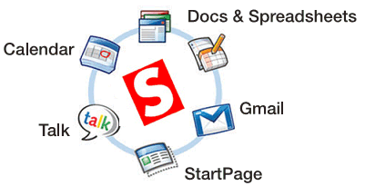
How does cloud computing benefit ME?
  Google
    Synchronize your Google Calendar
    Access and collaborate using Google Doc’s within Salesforce
    Output your data to a Google site
    And much more
    Google Apps Video
Notes:
Info World article
Synchronization Options
Several synchronization options are available:
Direction – The default is to synchronize information bi-directionally so updates made to one calendar automatically update the other. In some circumstances you may wish to only have information be updated in one direction (e.g., updates only flow from Google to Salesforce).
Frequency – How often a background synchronization is run. More frequent synchronizations will result in more up to date information.
Google Calendar – Google allows you to setup multiple calendars (e.g., my work calendar, my class schedule, etc.). You must choose one of these calendars to synchronize information with.
Notifications – The Google and Salesforce calendars have a number of incompatibilities (see Known Issues). For example Google support class schedule recurrences (occurs every Tues/Thurs or Mon/Wed/Fri) and Salesforce does not. Calendar events that utilize any of the incompatible features will not be synchronized. Receiving notifications sends you email when events cannot be synchronized. Notifications can be turned on and off at your discretion without interrupting the synchronization process.
Conflicts – These settings determine how conflicting event updates are handled. A conflict happens when the same calendar event is changed in both Salesforce and Google within the same synchronization period. If Most recent update is selected, the last change is synchronized, the other change discarded. Selecting Salesforce or Google means that the selected system is always used as the synchronization source in a conflict. Note that if the same event is deleted in one system and updated in another, the event is deleted from both systems.
Multiple Synchronizations
You can create up to 3 independent synchronizations. This can be used to merge multiple Google calendars into Salesforce, or to publish a Salesforce calendar into multiple Google calendars.
The product prevents the creation of synchronization “loops” - defined as a calendar that is used as both a source and target. For example, you cannot create a synchronization from Salesforce to Google Calendar 1, then from Google Calendar 1 to Salesforce again. Instead you would create a single bi-directional synchronization between the two.
discussing sf - http://www.infoworld.com/d/cloud-computing/google-salesforcecom-join-forces-business-apps-333

Slide 11




How does cloud computing benefit ME?
Google Integration
See your productivity soar when you use Gmail for business and send messages to contacts from inside Salesforce or log emails in Salesforce from Gmail.
Learn More
Instantly communicate with colleagues right from Salesforce - during sales or customer services calls, in discussions with partners, or when reviewing CRM data in Salesforce.
Share documents with your colleagues, partners, and customers so that everyone can work together in real time - no more emailing attachments or worrying about different versions floating around.
Manage your various work activities plus your personal and outside calendars all in one easy calendar interface with the checkbox simplicity and drag-and-drop convenience you would expect from Web 2.0.
Salesforce for Google Apps Product Tour Video Integrate video into slideshow
Notes:
Info World article
Synchronization Options
Several synchronization options are available:
Direction – The default is to synchronize information bi-directionally so updates made to one calendar automatically update the other. In some circumstances you may wish to only have information be updated in one direction (e.g., updates only flow from Google to Salesforce).
Frequency – How often a background synchronization is run. More frequent synchronizations will result in more up to date information.
Google Calendar – Google allows you to setup multiple calendars (e.g., my work calendar, my class schedule, etc.). You must choose one of these calendars to synchronize information with.
Notifications – The Google and Salesforce calendars have a number of incompatibilities (see Known Issues). For example Google support class schedule recurrences (occurs every Tues/Thurs or Mon/Wed/Fri) and Salesforce does not. Calendar events that utilize any of the incompatible features will not be synchronized. Receiving notifications sends you email when events cannot be synchronized. Notifications can be turned on and off at your discretion without interrupting the synchronization process.
Conflicts – These settings determine how conflicting event updates are handled. A conflict happens when the same calendar event is changed in both Salesforce and Google within the same synchronization period. If Most recent update is selected, the last change is synchronized, the other change discarded. Selecting Salesforce or Google means that the selected system is always used as the synchronization source in a conflict. Note that if the same event is deleted in one system and updated in another, the event is deleted from both systems.
Multiple Synchronizations
You can create up to 3 independent synchronizations. This can be used to merge multiple Google calendars into Salesforce, or to publish a Salesforce calendar into multiple Google calendars.
The product prevents the creation of synchronization “loops” - defined as a calendar that is used as both a source and target. For example, you cannot create a synchronization from Salesforce to Google Calendar 1, then from Google Calendar 1 to Salesforce again. Instead you would create a single bi-directional synchronization between the two.
discussing sf - http://www.infoworld.com/d/cloud-computing/google-salesforcecom-join-forces-business-apps-333
Video edit aoun 1:40 begin video

Slide 12
How does cloud computing benefit ME?
  Connect for Microsoft Outlook
    synchronize your contacts, tasks, and calendar events
    associate Outlook email messages with Salesforce records
    create cases from Outlook email messages
    map custom fields in Salesforce to fields in Outlook
  Connect for Microsoft Office
    Excel add in allows you to:
      Import Salesforce data into Excel and apply formulas and formatting
      Combine different data sets using Excel’s VLOOKUP function
      Refresh data in Excel with information from Salesforce
      Build dashboards using Excel pivot tables and charts
Notes:
Tired of searching through your sent email folder for an email you previously sent to a student? Use the integrated features in order to easiy attach a an email to a students record in sf

Slide 13
How does Salesforce benefit ME?
Marketing
  Track all data related to a campaign (date, location, costs)
  Track email blasts internally and view an aggregated record of all emails sent to a potential student
    Prevents excessive emails
  Track all potential lead data including survey data
  Calculate a Return On Investment
    Some marketing campaigns can be quite costly (print, radio etc)
      Given the current times of economic hardship, it is crucial to measure the effectiveness of marketing campaigns
  Increase our rate of conversion by capturing web-based inquiry data
  Help keep our data clean with the integrated de-duplication tools
Notes:
Well let me begin by providing a background to my group within the continuing education department and the type of marketing and data management problems we were encountering. I work with the off campus credit programs located in Freehold, Mays Landing, and Raritan Valley CC (now set to launch Fall 2009). We routinely have Open House events where we would capture potential student contact information and distribute surveys. Later on this survey data was then entered into a system that would aggregate the information which at first was great. But then how do we aggregate all of this survey data and analyze it efficiently when it is was exported into individual spreadsheets? How do I track that potential student data to a current record if they decide to enroll? How do I calculate my ROI and determine if the event was worth the expense? In this time of budgetary crisis it is crucial to be able to identify whether or not a marketing campaign is effective and among many others things salesforce provided us the ability to do just that.
I will provide you with two examples of how salesforce dramatically effected our potential student data management as well as positively impacted our rate of conversion

Slide 14
How does Salesforce benefit ME?
Email Blasts
  Vertical Response
    We utilize this Email Service Provider to send out mass emails to potential students
    This email provided basic contact information and a series of links including one back to a web-based inquiry form
    Auto Response Rules- allow us to create an effective message back to the student within minutes of clicking submit
    Assignment & Workflow Rules provides the ability to assign a follow-up task to a specific staff member based on criteria and is notified via email
    This automation has lead to a higher rate of conversion as we were able to respond to inquiries in a timely fashion.
Notes:
Salesforce currently has an integrated survey tool via Poltzer that allows you to create basic surveys fairly easy. However, for me personally I was accustomed to using another survey tool and continue to utilize it for those more advanced survey formats (matrix type questions etc) and simply import that data into salesforce

Slide 15
How does Salesforce benefit ME?
Survey Tools
  Poltzer
    Integrated survey tool great for creating basic surveys and have the data automatically tracked in salesforce
    Send a survey link out in your mass email and combine the two great services
  Choose to use your own external survey tool for more advanced survey reporting and import the data into salesforce
Notes:
I have only recently begun to use the integrated Polzter tool which in my opinion works best for basic surveys. I find for more advanced surveys (ie matrix type question) using an external survey tool and simply importing the data works best. We are also researching other survey tools for possible future integraton that may serve the more advanced tools in a better capacity
Get nonprofit quote for click tools

Slide 16
How does Salesforce benefit ME?
Web to Lead Forms
  Easily created a web inquiry form to post on our website
  Use Auto Response Rules
    Create a message to be sent to the student upon submission
  Use Assignment & Workflow Rules
    Specify criteria to assign tasks to specific co-workers
    Increase your rate of conversion by using workflow rules to respond back to the end user within minutes
Notes:
Future custom objects
Course information
Advising information
Tuition lookup tables
Calculate per course amount based on tuition
Load course data associated with record type –

Slide 17


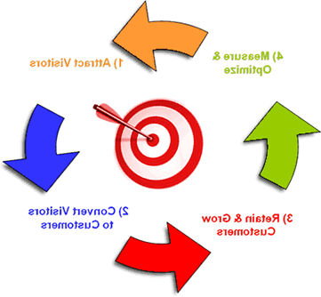
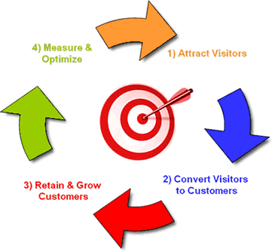


Marketing via Salesforce
Send email blasts
Online Advertising
Include URL directing leads to online form
Online form collects data and tracks in Salesforce
Create an automated email notification which s immediately sent back to end user
Create a assignment rule that delegates a task & email notification to a coworker to contact lead within minutes

Slide 18
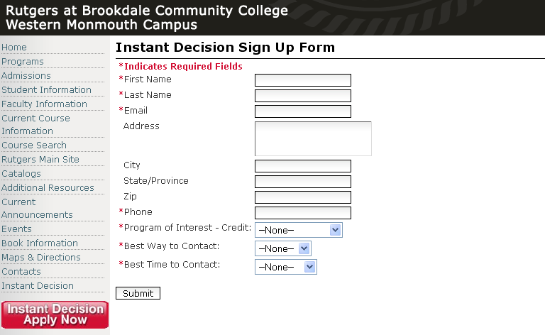
Web to Lead – Western Monmouth Higher Education Center’s Instant Decision Form
* - Denotes Required Fields

Slide 19
How can Salesforce benefit YOU?
Data Aggregation
  Have one point of storage for all data
    Marketing Initiatives (Campaigns)
      Vertical Response- Utilize this integrated Email Service Provider to track emails sent to each student, all email related data (open, click thru’s etc) as well as if the email contributed to the learn conversion
    Potential Students (Leads)
    Current Student Data (Accounts)
    Problems or Issues (Cases)
    Aggregate this data with Visual graphs (Dashboards)
    Create easy on demand reports for any data object (Reports)
    Use custom applications/objects to track an other data sets

Slide 20



Data Aggregation
Open House Events Generate Leads
Track Open House data using campaigns - date, time, location, cost, attendees
Easily Import these leads into Salesforce
OR
Connect via mobile device and add the lead directly to

Slide 21
Lead Activity
Maintain Aggregated Lead activity attached to the prospective student record
Track correspondence
  Log Call
  Track appointment activity
  Track all emails sent to prospective students
  Log any problem or issue associated with a prospective student

Slide 22
How does Salesforce benefit ME?
The salesforce platform mass email and web to lead forms, enabled us to:
Notes:
Future custom objects
Course information
Advising information
Tuition lookup tables
Calculate per course amount based on tuition
Load course data associated with record type –

Slide 23
Other Web 2.0 Marketing Tips
Drive potential leads to your web to lead inquiry forms using these tips!
Search Engine Optimization
The following are all salesforce Compatible:
Google Adwords – sf google adword demo video
Google Analytics
Facebook
  Business Profile
  Fan Page
  Facebook Ads
Twitter
Firefox Addins – SF toolbar
Notes:
Twitter app - http://blogs.zdnet.com/BTL/?p=15032

Slide 24
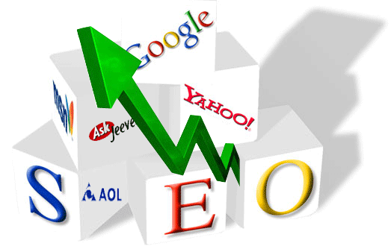
Search Engine Optimization
Increase your page rank by adding links to other websites that reference your page. Here are a few starting points:
  Begin by browsing current university websites of affiliated or similar programs. Be sure links to your site are present
  External Sites
    NJ.com
    Google Maps
    Wikipedia

Slide 25
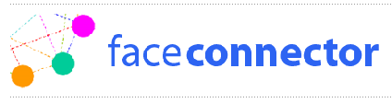
Future Customizations-Intergrating Facebook via the faceforce connector
Facebook
Combine your Facebook network with Salesforce contacts
Build better personal and professional relationships
Never forget another customer's birthday
Notes:
Description
Successful business relationships are personal relationships. With Faceconnector for the AppExchange, you can for the first time unleash the power of your personal network on Facebook to strengthen and build more relationships with customers, colleagues, and business partners.
Faceconnector for the AppExchange complements traditional CRM data with dynamically updated personal data and photos. The seamless integration pulls critical Facebook profile information into your Salesforce Account, Lead, and Contact records in real time, providing you with an instant 360º view of customers, prospects, and business associates. In today’s competitive business landscape, relationships have never mattered more. Whether you are in sales, business development, or some other role, gain an instant edge with Faceconnector.
Faceforce fact sheet - http://sites.force.com/appexchange/servlet/servlet.FileDownload?retURL=%2Fappexchange%2Fapex%2Fuploadedcontent%3Fid%3D00P30000003TbTjEAK&file=00P30000003TbTjEAK

Slide 26
Future Customizations
Facebook
Catching the Web 2.0 Wave
http://sites.google.com/site/snsineducation/
Faceforce connector
Faceconnector is a mashup that pulls Facebook profile and friend information into Salesforce CRM. To learn best practices and how real companies are succeeding with social media in sales & marketing, check out our book at www.thefacebookera.com

Slide 27
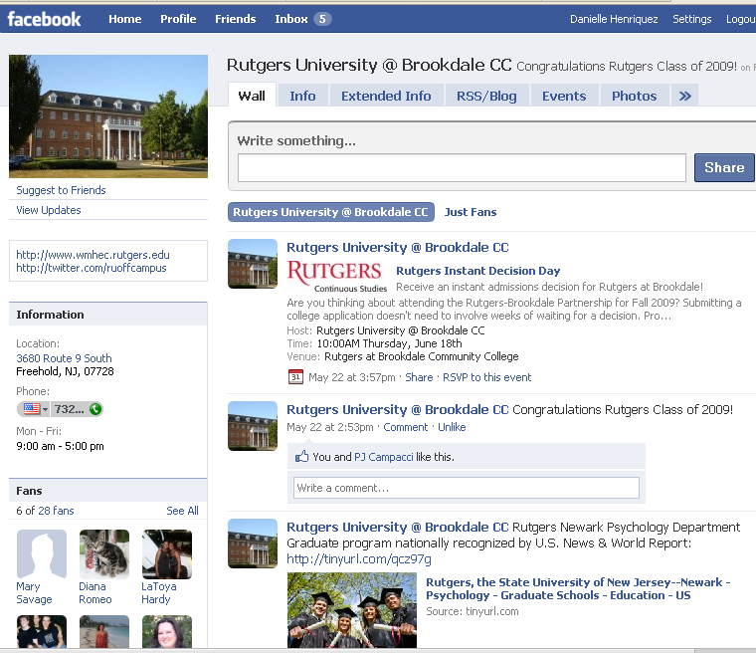
Facebook

Slide 28
What is Twitter?
Twitter is a free social networking and micro-blogging service that enables its users to send and read other users' updates known as tweets.
Tweets are text-based posts of up to 140 characters in length which are displayed on the user's profile page and delivered to other users who have subscribed to them (known as followers).
Senders can restrict delivery to those in their circle of friends or, by default, allow anybody to access them.
Users can send and receive tweets via the Twitter website, Short Message Service (SMS) or external applications.
The service is free via the Internet, but using SMS may incur phone service provider fees.
(Wikipedia)

Slide 29
What is Twitter?
YouTube Videos:
Twitter In Education Part 1 – Further explanation of Twitter and how it works
Twitter in Education Part 2 – Issues of Twitter in the classroom and to help unify student disjointed body
  Interview with David Parry
    Assistant Professor University of Texas at Dallas

Slide 30
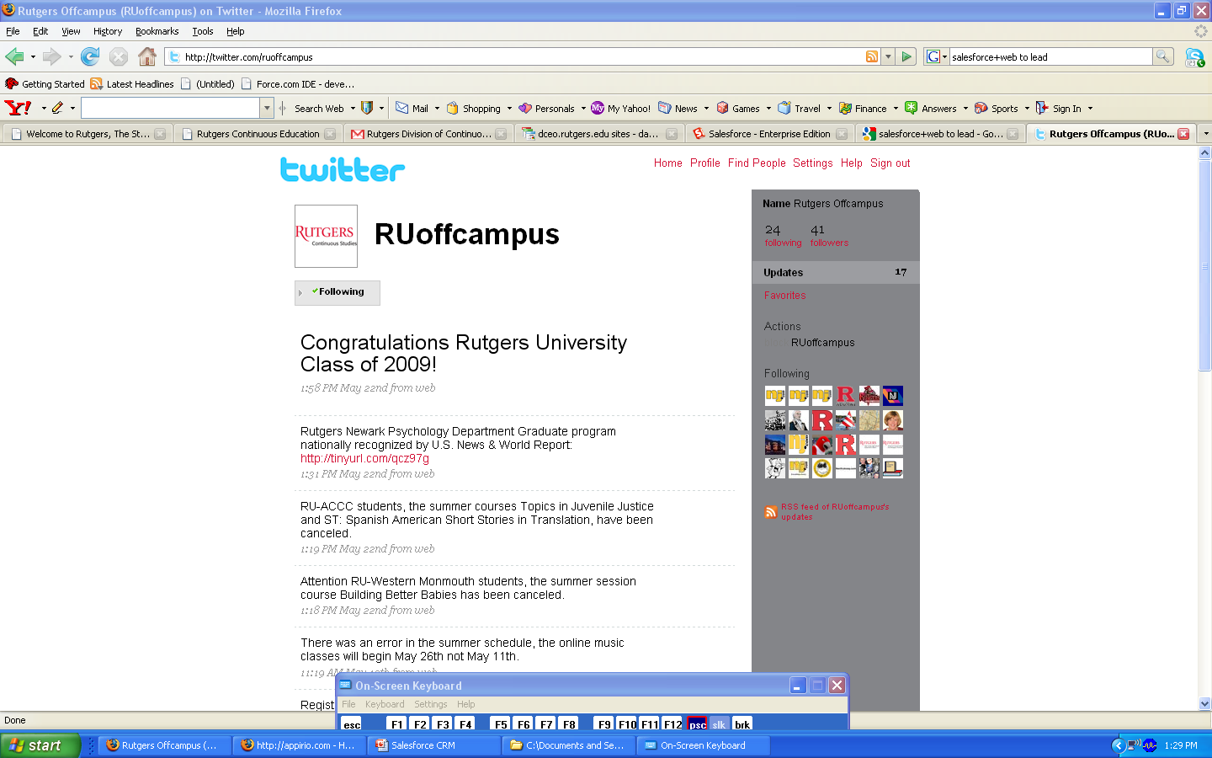
Twitter
Use Twitter to advertise:
  Open House Events
  Admissions Deadlines
  Course Announcements
    Additions
    Cancelations
    Registration Dates
  Graduation Information/Deadlines
  Public Announcements regarding your program

Slide 31
Twitter

Slide 32
Twitter Customer Service App
http://www.informationweek.com/news/services/saas/showArticle.jhtml?articleID=215901505

Slide 33

Salesforce CRM – Proposed Applications
Salesforce.rutgers.edu
Notes:
http://www.thesoundarchive.com/sw.asp
http://members.tripod.com/SoundBytes1/star_wars/sw.html
Star wars sound files
Salesforce ideas site: https://sites.google.com/a/dceo.rutgers.edu/salesforceideas/

Slide 34
Future Proposed Customizations
Create One main CE portal that links Salesforce OC Budget DB links, DICES, CERKIT, and all other apps using single sign on
Create Custom Apps to include the following:
  Student Services
    Course enrollment tracking
    Advising
  Financial Services
    Course Tuition breakdown
Weekly scheduled data load from ACS Datawarehouse

Slide 35
Salesforce Taskforce Meetings
Create Documented Policies & Procedures for the Following:
  Privacy Policy
  End User Agreement
  On Going Projects (Change Policy for admins)
  Data Dictionary – to organize current data fields on backend
  New user intake form – virtual billing Establish an intake form for groups that would want to begin to use salesforce which asks for an account to charge
Address lack of communication back to groups & end users
Routine brief end user survey to address needs & satisfaction
Create One Point of contact for each unit
  This person serves as admin for group
  Responsible for administrating trained policies
Notes:
Problem with previous training
Ss- understanding the data
https://sites.google.com/a/dceo.rutgers.edu/salesforceideas/salesforce
Use scrolling marquee feature in sf to communicate poicies back to end users or link in customlinks area
Resources for policies https://sites.google.com/a/dceo.rutgers.edu/salesforceideas/Home/salesforce-policy---procedures/meetings/minutes-20090202 t to strike out one their own
Strategy for groups that may wa
Create record type for web to case – sf changes

Slide 36
Salesforce Taskforce Meetings
Create end user meetings that meet on a bi-yearly basis
  Attend other salesforce end user meetings to form an example
  Discuss new sf updates (free seasonal)
  Discuss new CEO updates & added apps from app exchange
  Discuss the potential of cross marketing via an aggregated newsletter with links to web to leads forms or each unit (setup by group admin).
Provide hands on training sessions
Create Documented help files Camtasia videos for additional support
Additional serivces to assist with user adoption
Notes:
End user task training
Import/export data-steps to properly imprt to avoid duplication
Sending an email bast
Admn training
Customizing fields??
Web to lead forms
Google adwords, analytics, facebook??

